Slide 1

A PRESENTATION ON DEVELOPING WEBSITE FOR SIAMAQ PORTAL DEVELOPED FOR SIAMAQ CONSULTANCY PVT. LTD., PUNE BY SEAT NO:-367617 PURVA DILIP WARKE KCE’S INSTITUTE OF MANAGEMENT AND RESEARCH, JALGAON 2022-2023

Slide 2
INDEX
1. Company Profile
2. Introduction of Project
3. System Requirement
4. System Design
5. Screen Layouts
6. Conclusion
7. Reference

Slide 3
01
COMPANY PROFILE

Slide 4
COMPANY PROFILE
Siamaq Consultancy, a small IT company that provides business solutions around the world. Siamaq started its brand building journey in the year 2019. Our journey has been full of ups & downs, but we’ve overcome every huddle in our way with our sheer determination to deliver on our promises.
Siamaq Consultancy was started with small determined team of 03 and over the years we’ve grown from a team to a family of 50. We have mastered our skill set in all the domains and pioneer in delivering measurable results to our clientele.
Siamaq Consultancy Pvt. Ltd. is a fastest creating web progression association arranged in pune, India. Siamaq System Creates Bright and Functional Website Design for Businesses and Siamaq Consultancy Pvt. Ltd. is a fastest creating web progression association arranged in pune, India. Siamaq System Creates Bright and Functional Website Design for Businesses and Individuals.
Create world class digital presence with Siamaq consultancy. We are integrated marketing communication agency with capabilities and experience to grow and enhance your business both locally and globally. We are leading creative marketing agency specializing in branding, design and digital.

Slide 5
02
INTRODUCTION OF PROJECT

Slide 6
INTRODUCTION OF PROJECT
Introduction to Project
Title :- Developing website for Siamaq Portal.
Domain :- Web Technology.
Front-End :- HTML, JSP, CSS, JavaScript, Bootstrap, jQuery.
Back-End :- Java (Servlet), Tomcat-Server 9.0.
2. Project Objective
“Siamaq Portal” is a Clean Modern Web Based Website for Online Job Hiring to our company.
The website “Siamaq Portal” provides an easy and convenient search website for the job seekers to find their desired jobs and for the recruiters to find the right candidate.
Consultancy Company offers job opportunities for job seeker and also facilitates find other companies job and to post job openings.
Our project hots a diverse range of job openings, from entry-level positions to senior roles, We regularly update our listings to ensure you have access to the latest opportunities within our company.

Slide 7
03
SYSTEM REQUIREMENT

Slide 8
3.1 NEED OF SYSTEM
To offers convenience and efficiency to both job seekers and employers.
To include resume-building guidance, interview tips, career advice articles, and access to industry news and updates.
to require a siamaq portal, where job seeker can easily browse and search for relevant job openings across multiple industries and sectors.
To addresses job seeker's need by hosting job postings from various companies and sectors.
To job seekers require accurate and up-to-date information about job vacancies, including job descriptions, requirements, and application deadlines. Siamaq Portal fulfills this need by providing detailed and comprehensive job listings.
Siamaq Portal provide a centralized and easily accessible platform for job seekers to explore a wide range of job opportunities.

Slide 9
3.2 SOFTWARE AND HARDWARE REQUIREMENTS
MINIMUM SOFTWARE REQUIREMENTS
MINIMUM HARDWARE REQUIREMENTS
Operating System : Windows 7,8,10, 32/ 64-bit.
Front end : HTML, CSS, JavaScript, jQuery, Bootstrap
Back end : Java, MySQL Database.
Development Tool : Eclipse, MySQL Workbench 8.0
Sever : Apache Tomcat 8.5.8
Browser : Chrome or Firefox or Internet Explorer
Processor : Intel(R)Core(TM)
HDD : 10 GB
Monitor : Any Normal Monitor
Mouse : Any Normal Mouse

Slide 10
04
SYSTEM DESIGN

Slide 11
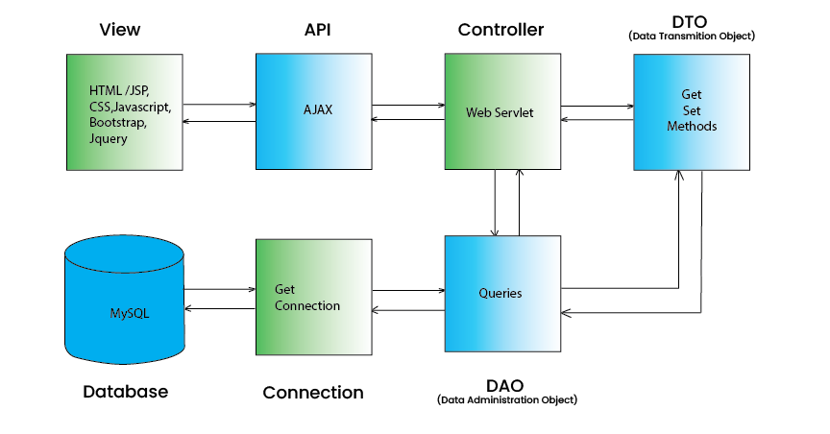
4.1 PROJECT ARCHITECTURE

Slide 12
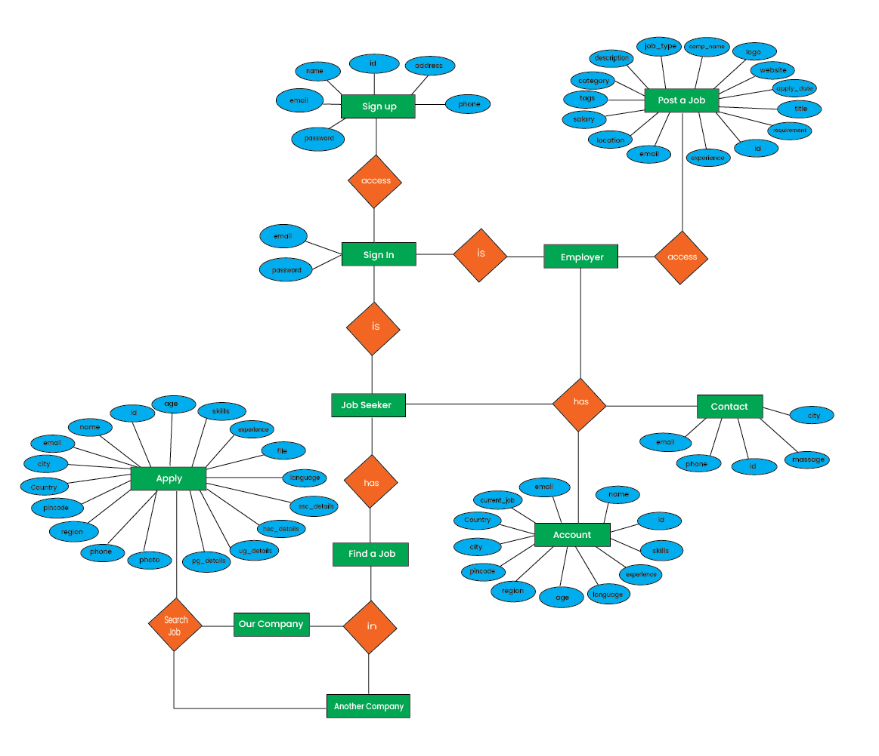
4.2 ENTITY RELATIONSHIP DIAGRAM

Slide 13
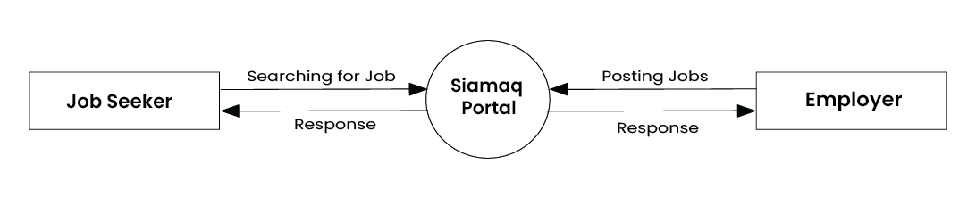
4.3 DATA FLOW DIAGRAM LEVEL 0

Slide 14
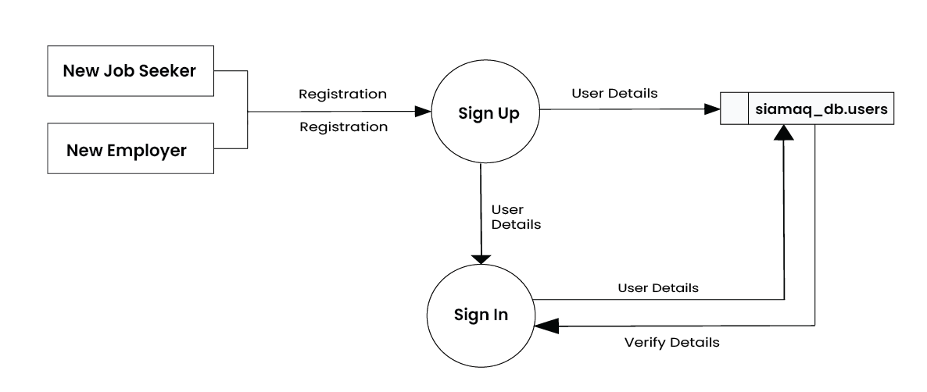
4.3 DATA FLOW DIAGRAM LEVEL 1
FOR SIGN-UP

Slide 15
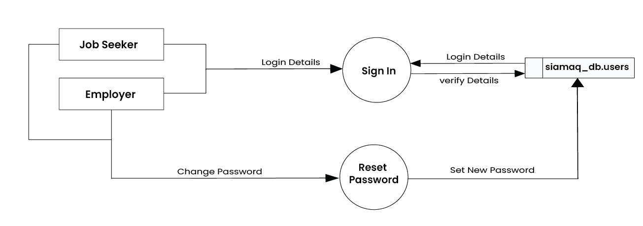
4.3 DATA FLOW DIAGRAM LEVEL 1
FOR SIGN-IN

Slide 16
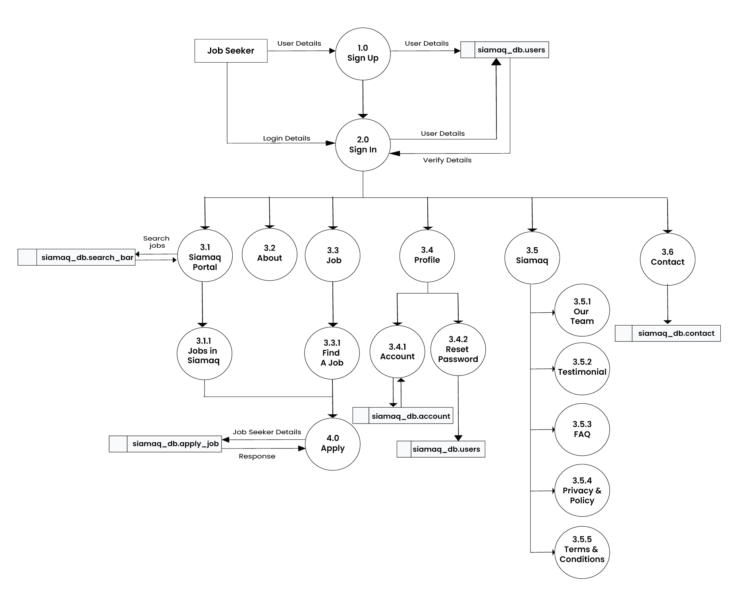
4.3 DATA FLOW DIAGRAM LEVEL 2
FOR JOB SEEKER

Slide 17
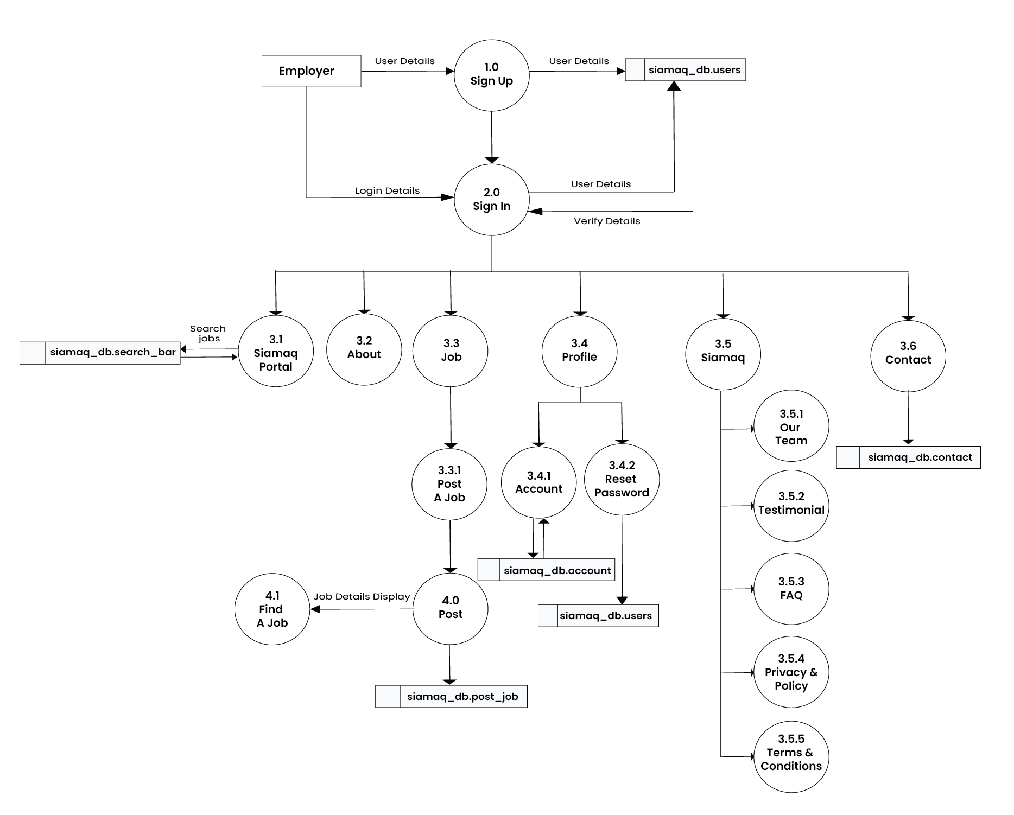
4.3 DATA FLOW DIAGRAM LEVEL 2
FOR EMPLOYEER

Slide 18
05
SCREEN LAYOUTS

Slide 19
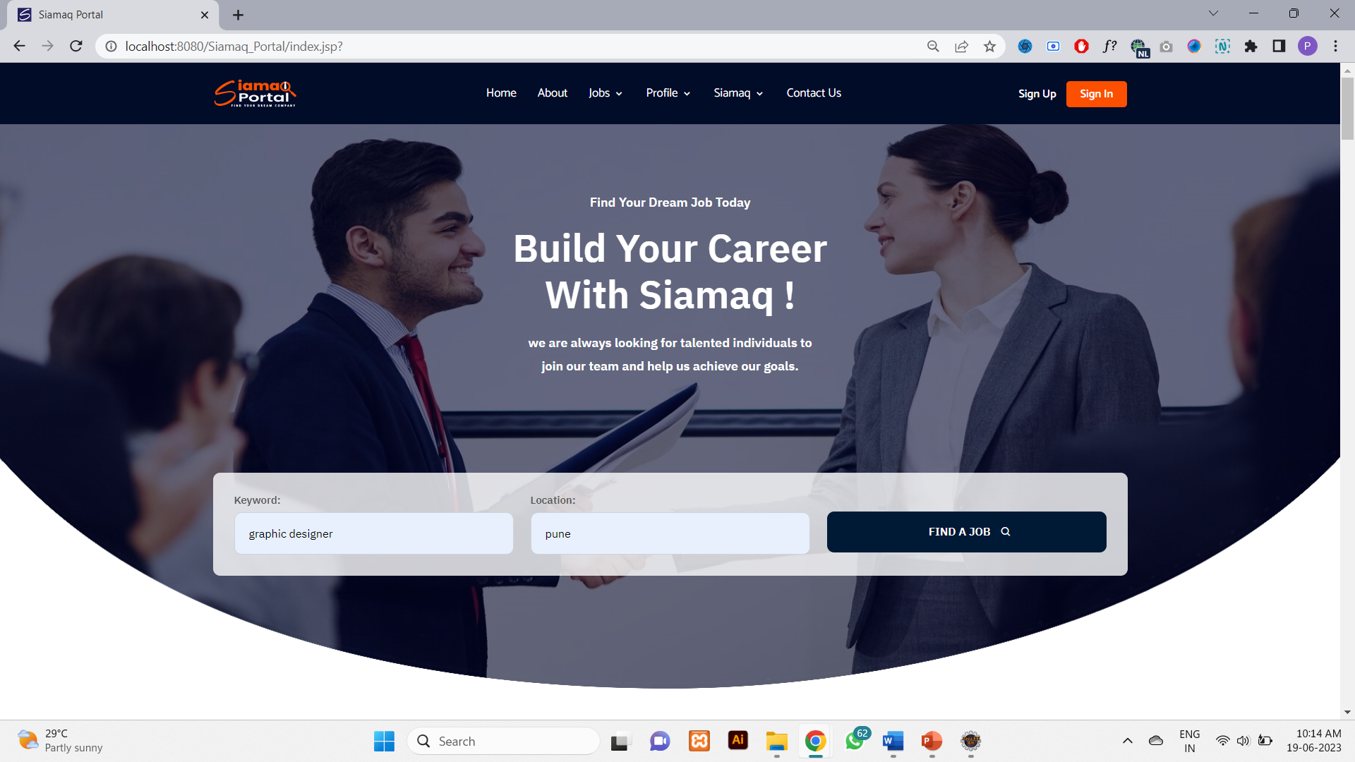
Fig 1.1 Home Page ( Main & Search Section )

Slide 20
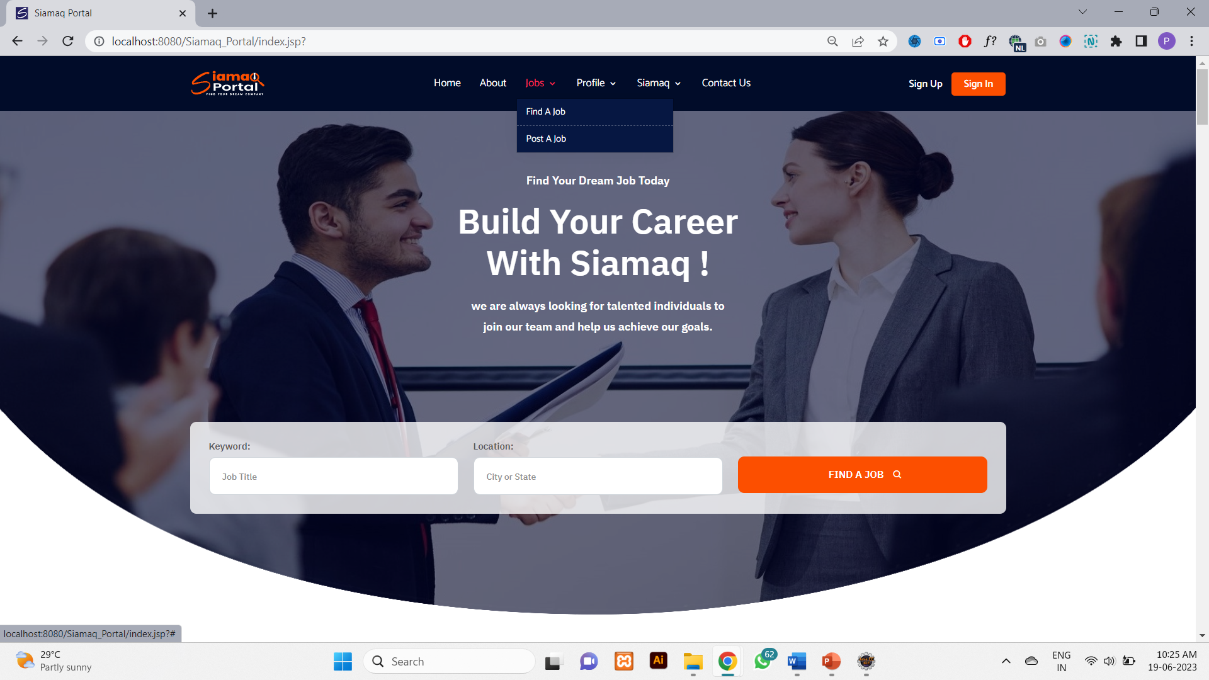
Fig 1.1 Home Page ( Header Section )

Slide 21
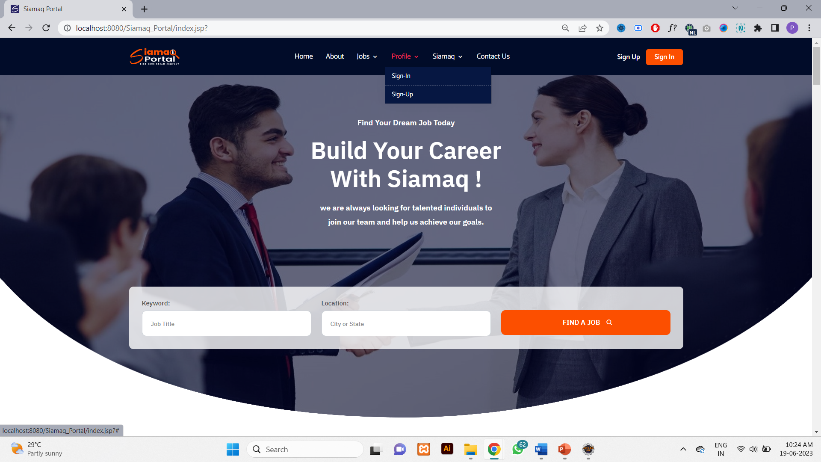
Fig 1.1 Home Page ( Header Section )

Slide 22
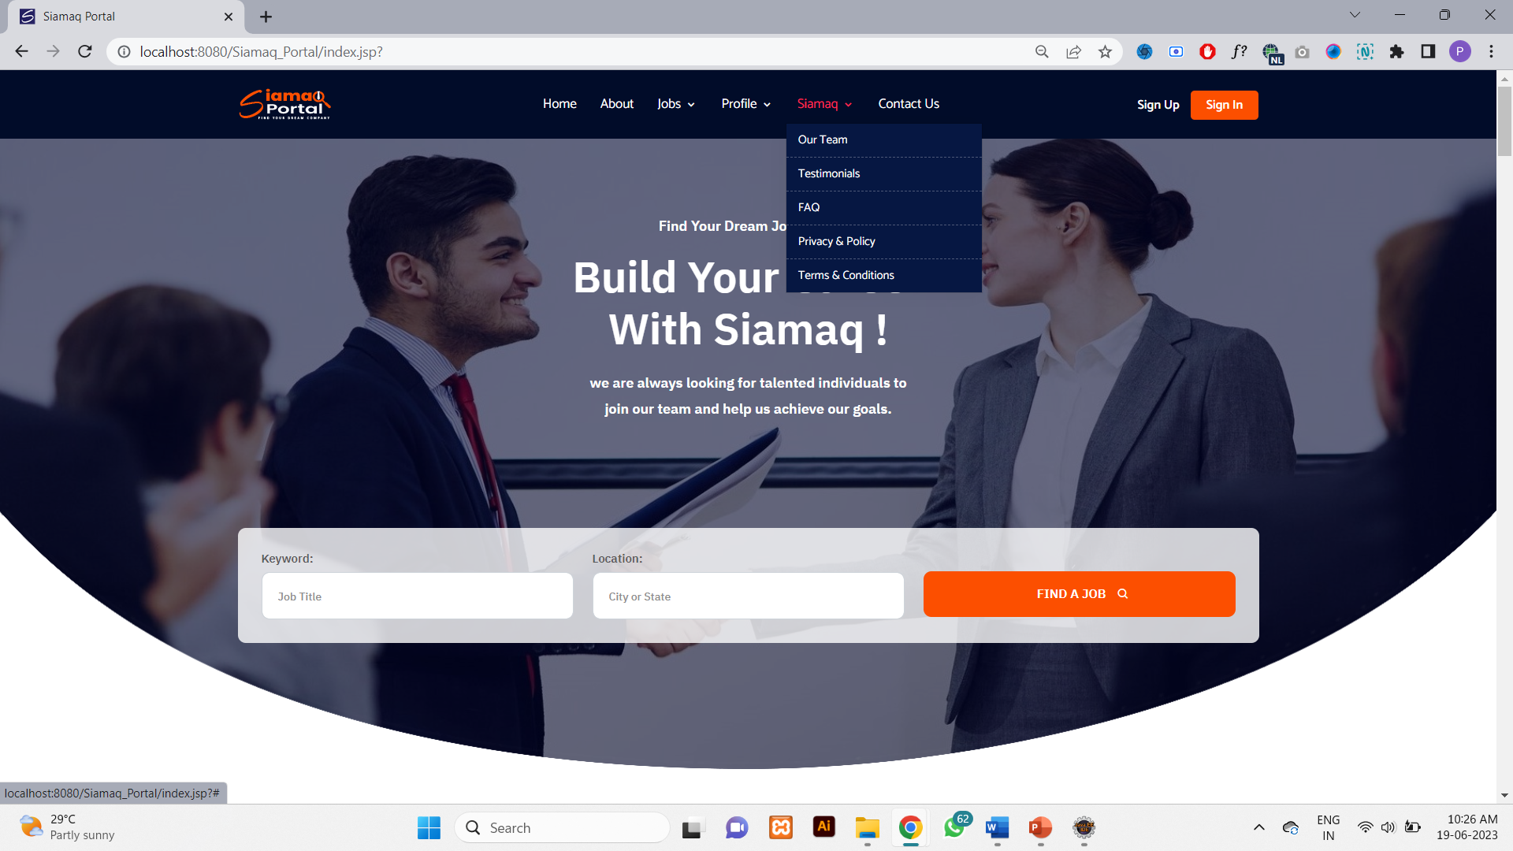
Fig 1.1 Home Page ( Header Section )

Slide 23

Fig 1.1 Home Page ( About Section )

Slide 24
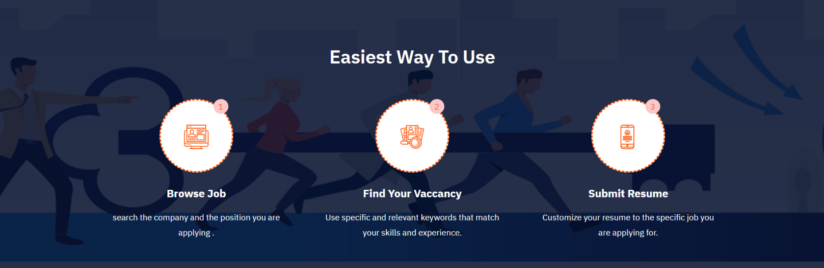
Fig 1.1 Home Page ( Easiest Way TO Use Section )

Slide 25
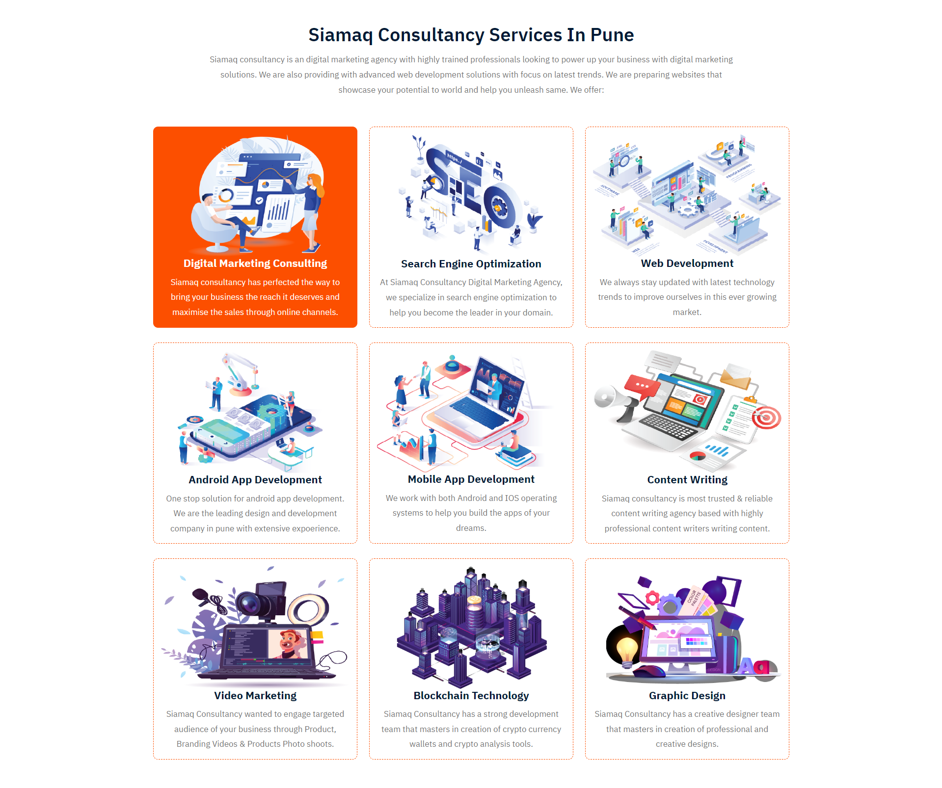
Fig 1.1 Home Page ( Services Section )

Slide 26
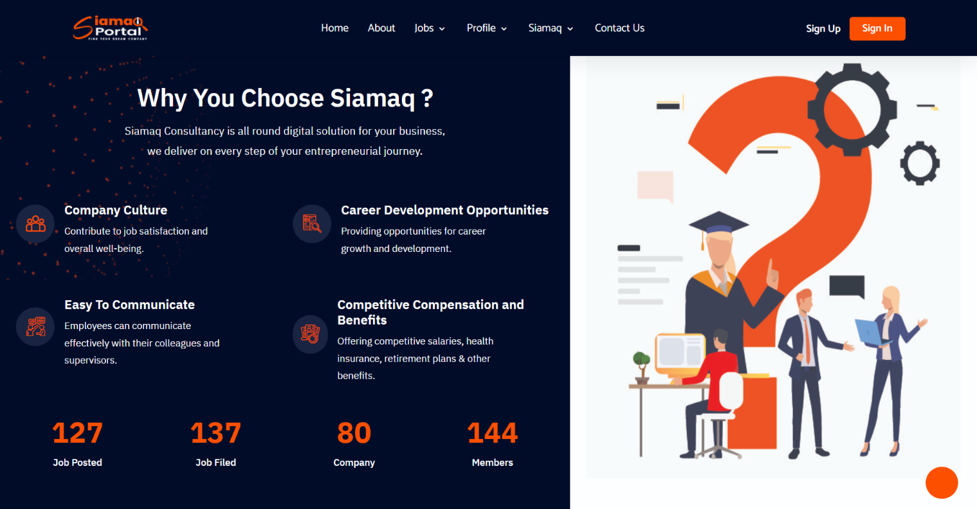
Fig 1.1 Home Page ( Why You Choose Siamaq Section )

Slide 27
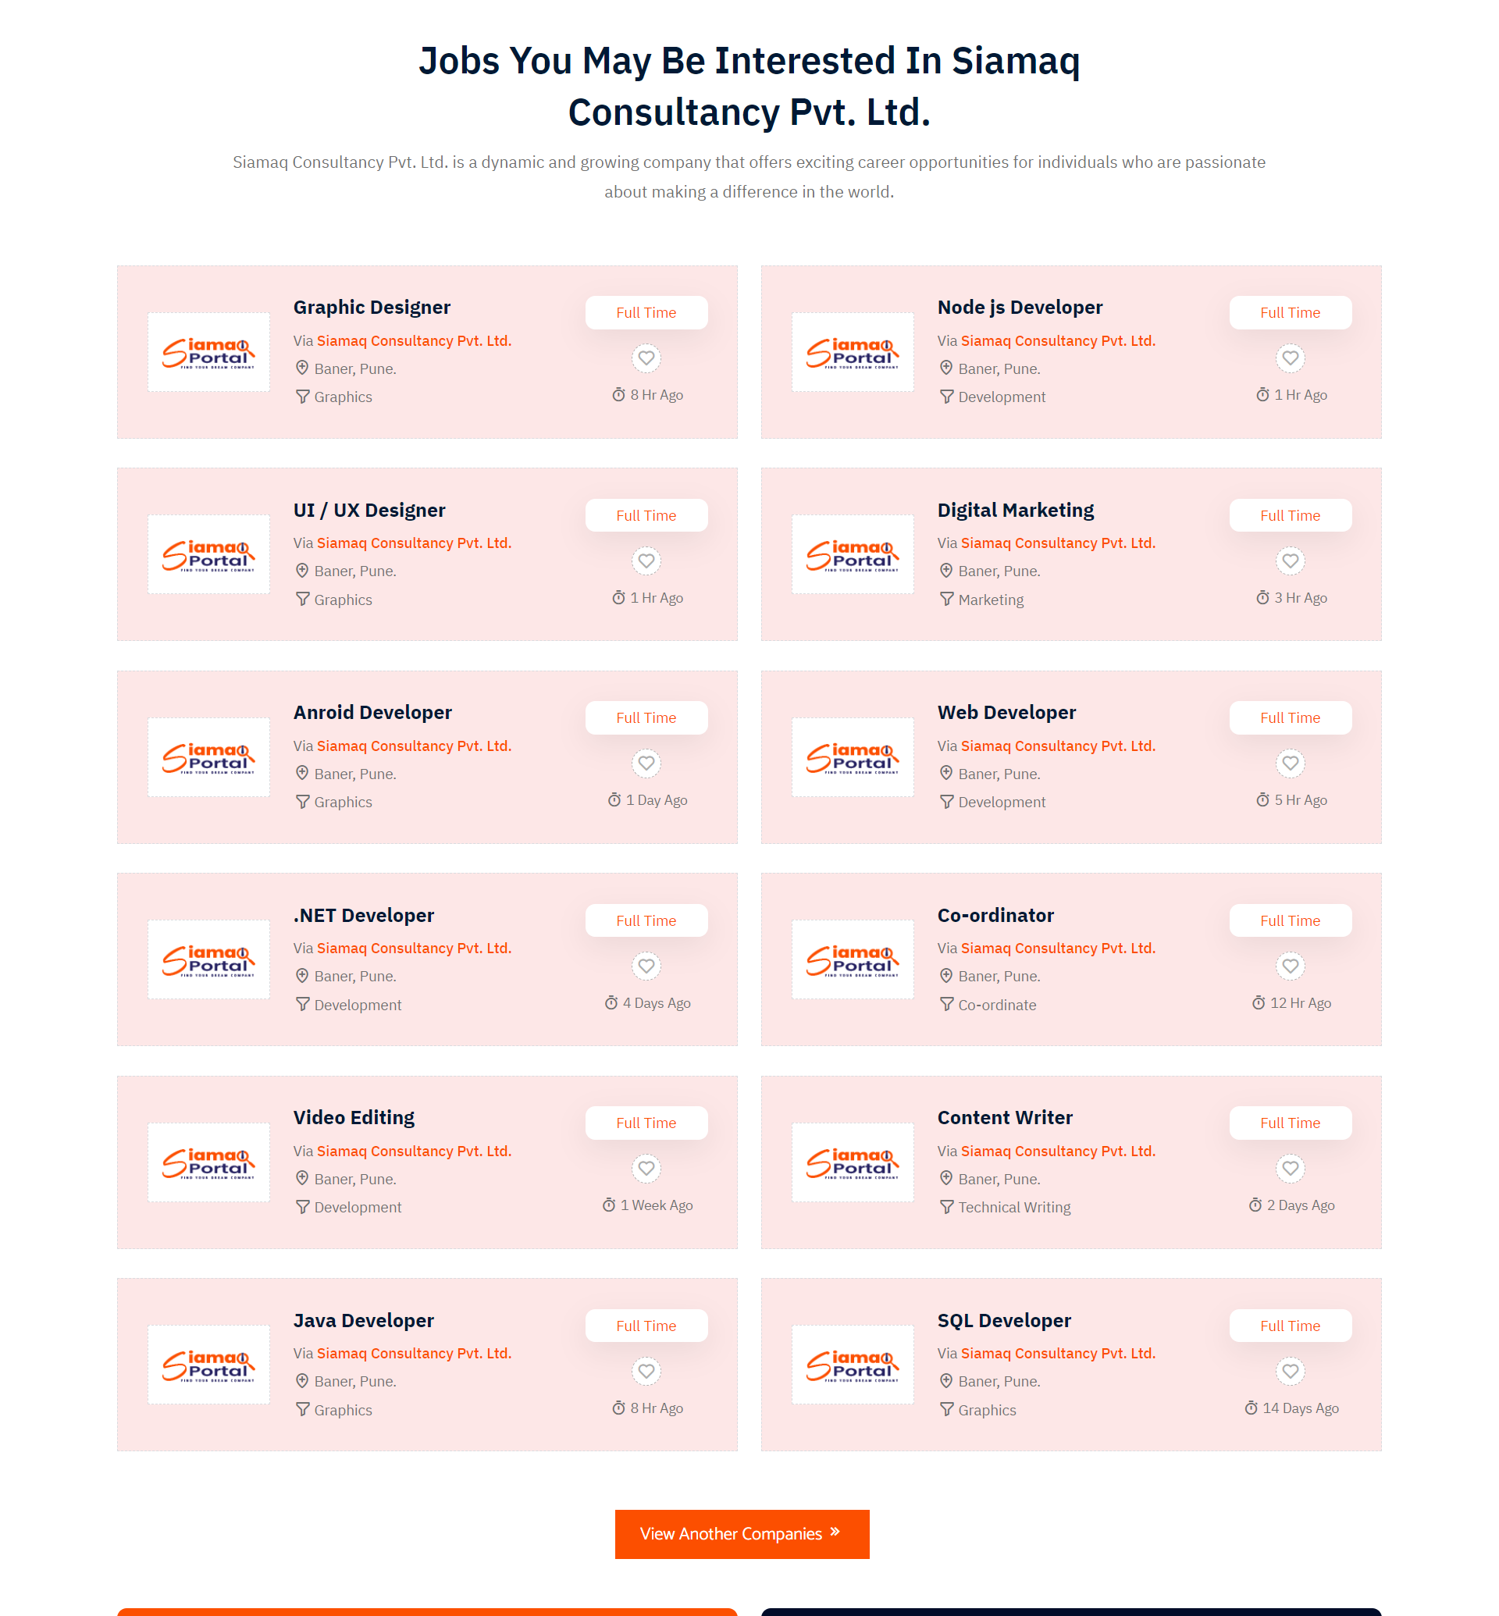
Fig 1.1 Home Page ( Jobs in Siamaq Section )

Slide 28
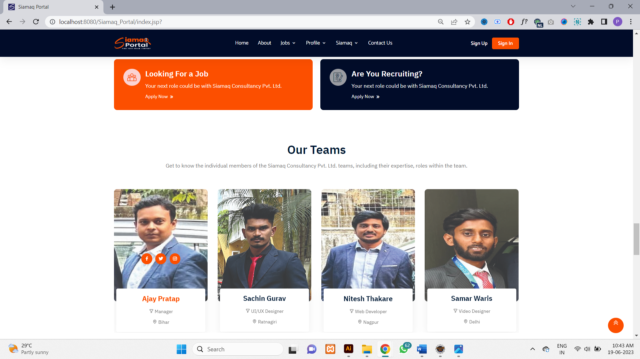
Fig 1.1 Home Page ( Our Team Section )

Slide 29
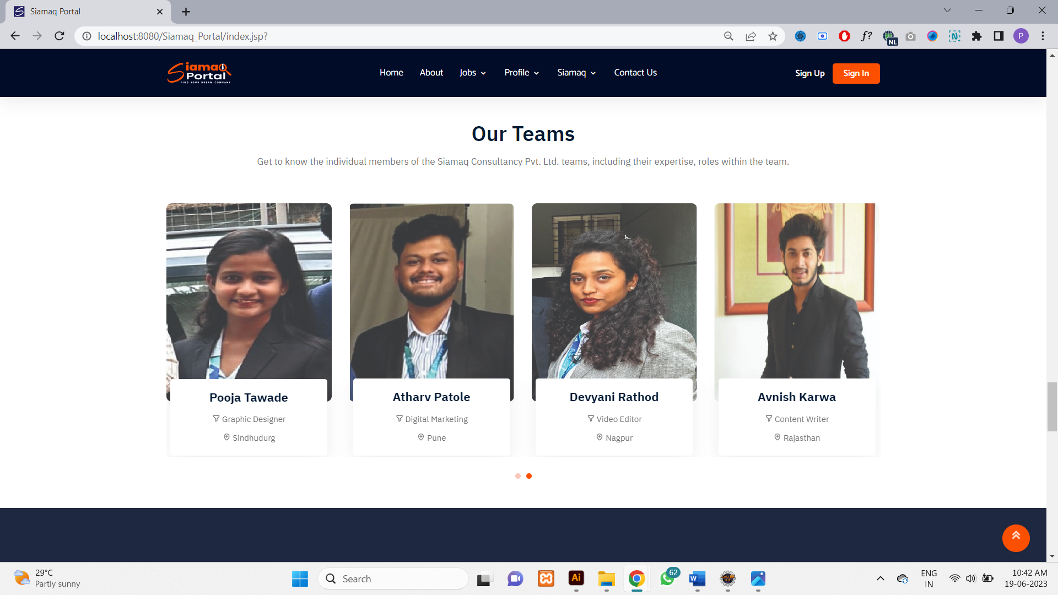
Fig 1.1 Home Page ( Our Team Section )

Slide 30
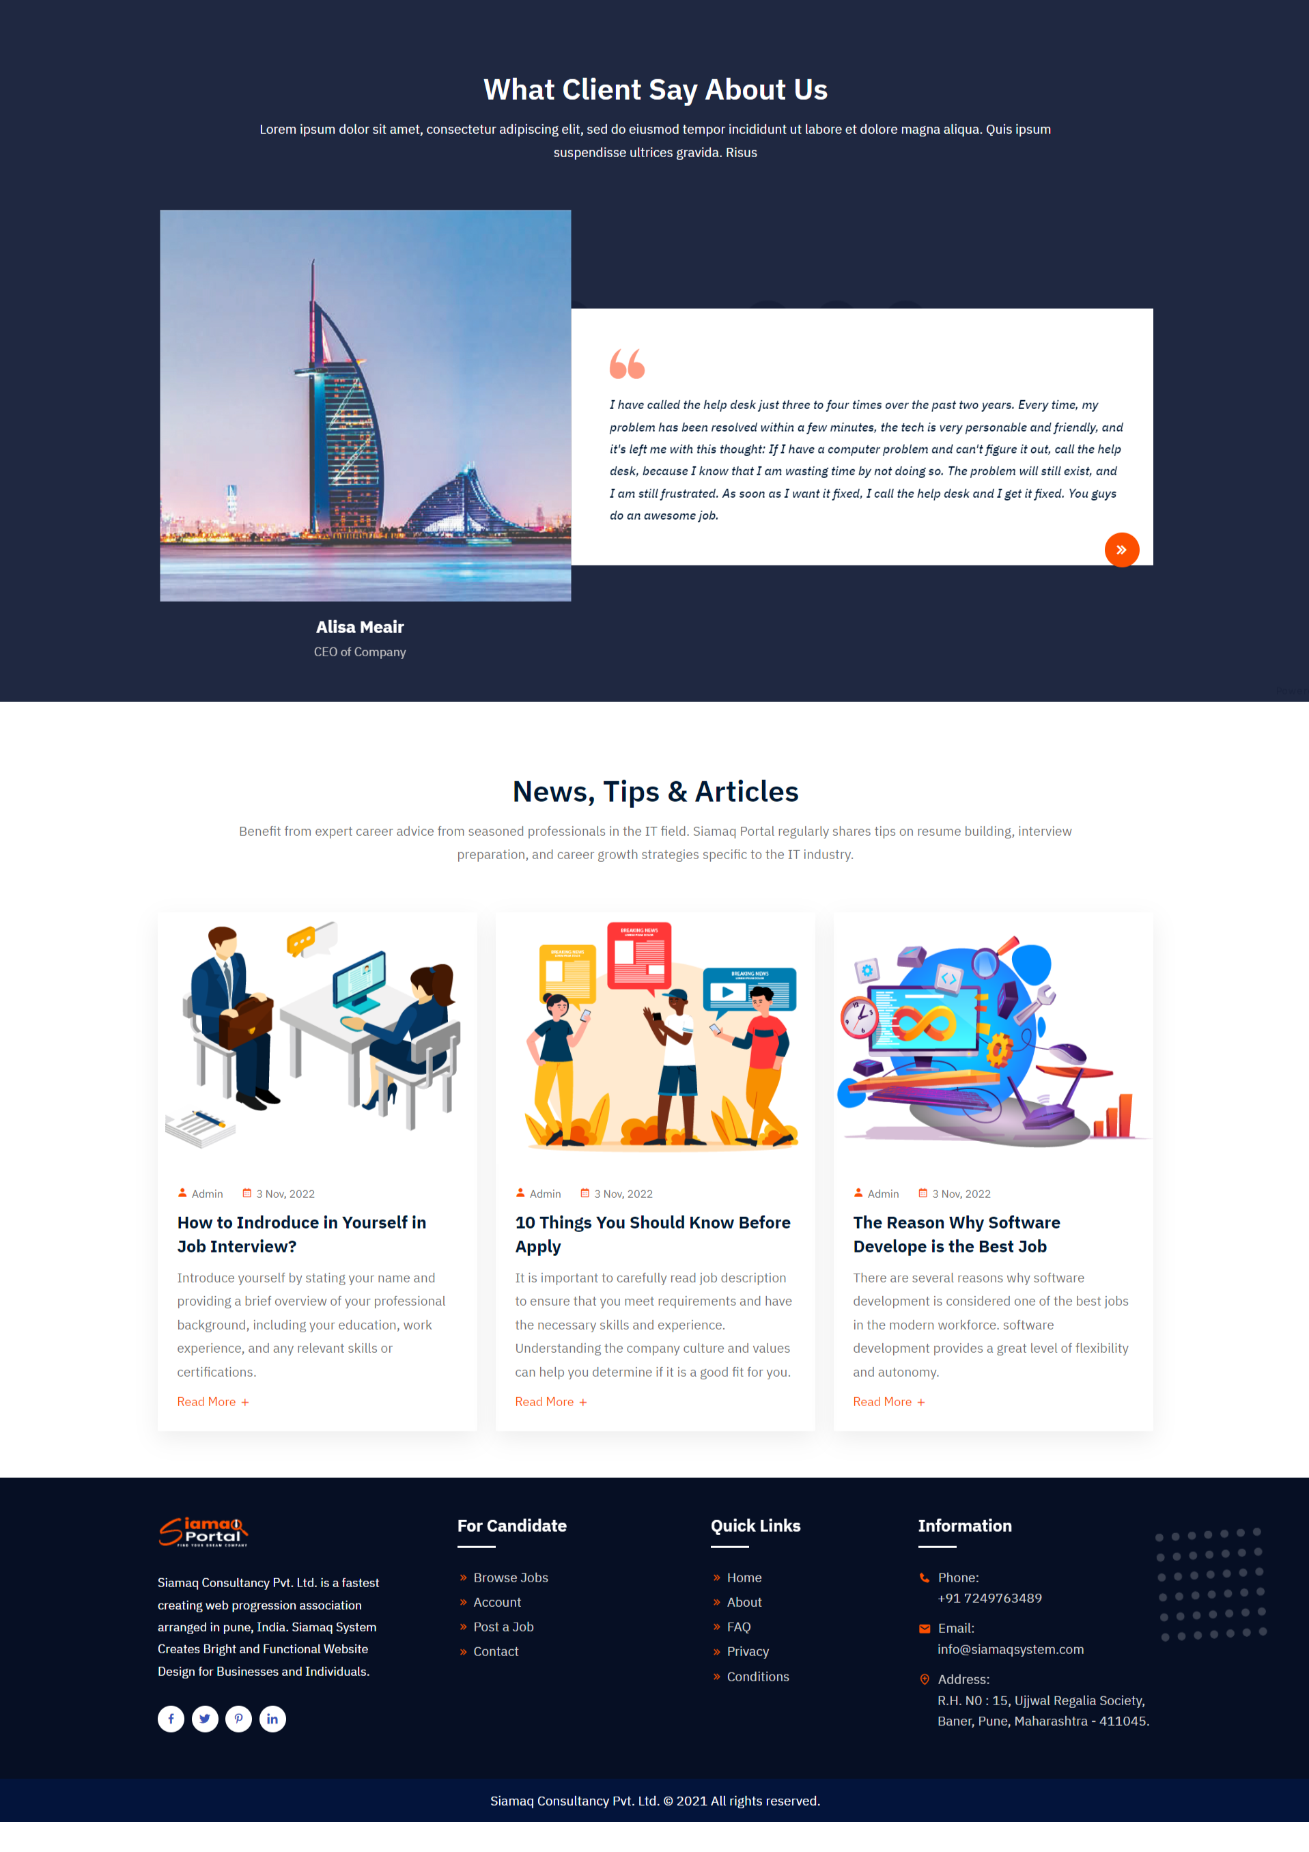
Fig 1.1 Home Page ( Easiest Way TO Use Section )

Slide 31
Fig 1.1 Home Page ( Blogs & Footer Section )

Slide 32
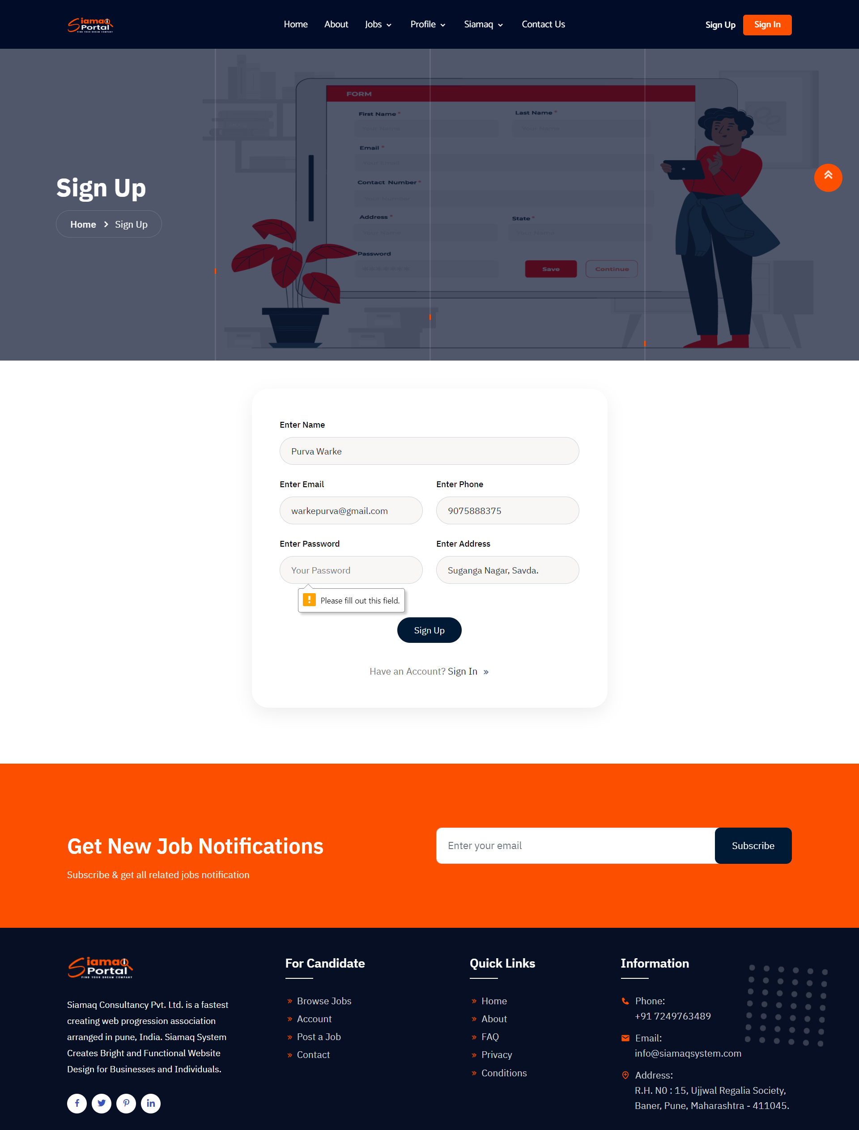
Fig 2. Sign Up Page

Slide 33
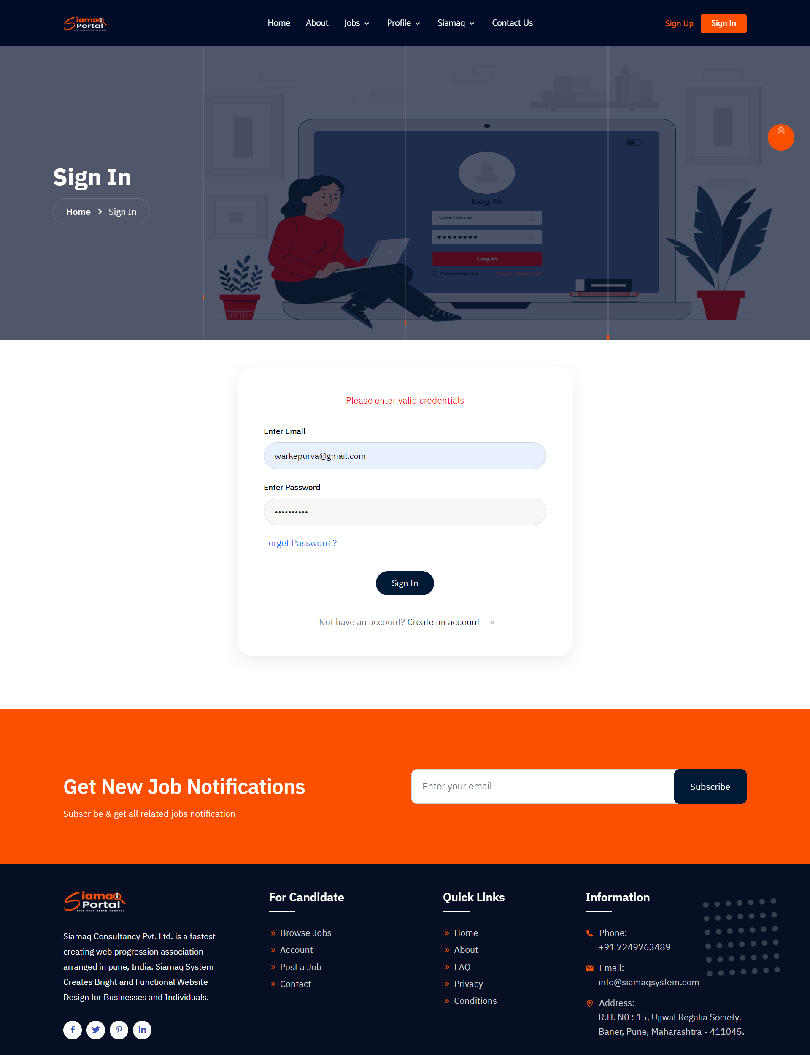
Fig 2. Sign In Page

Slide 34
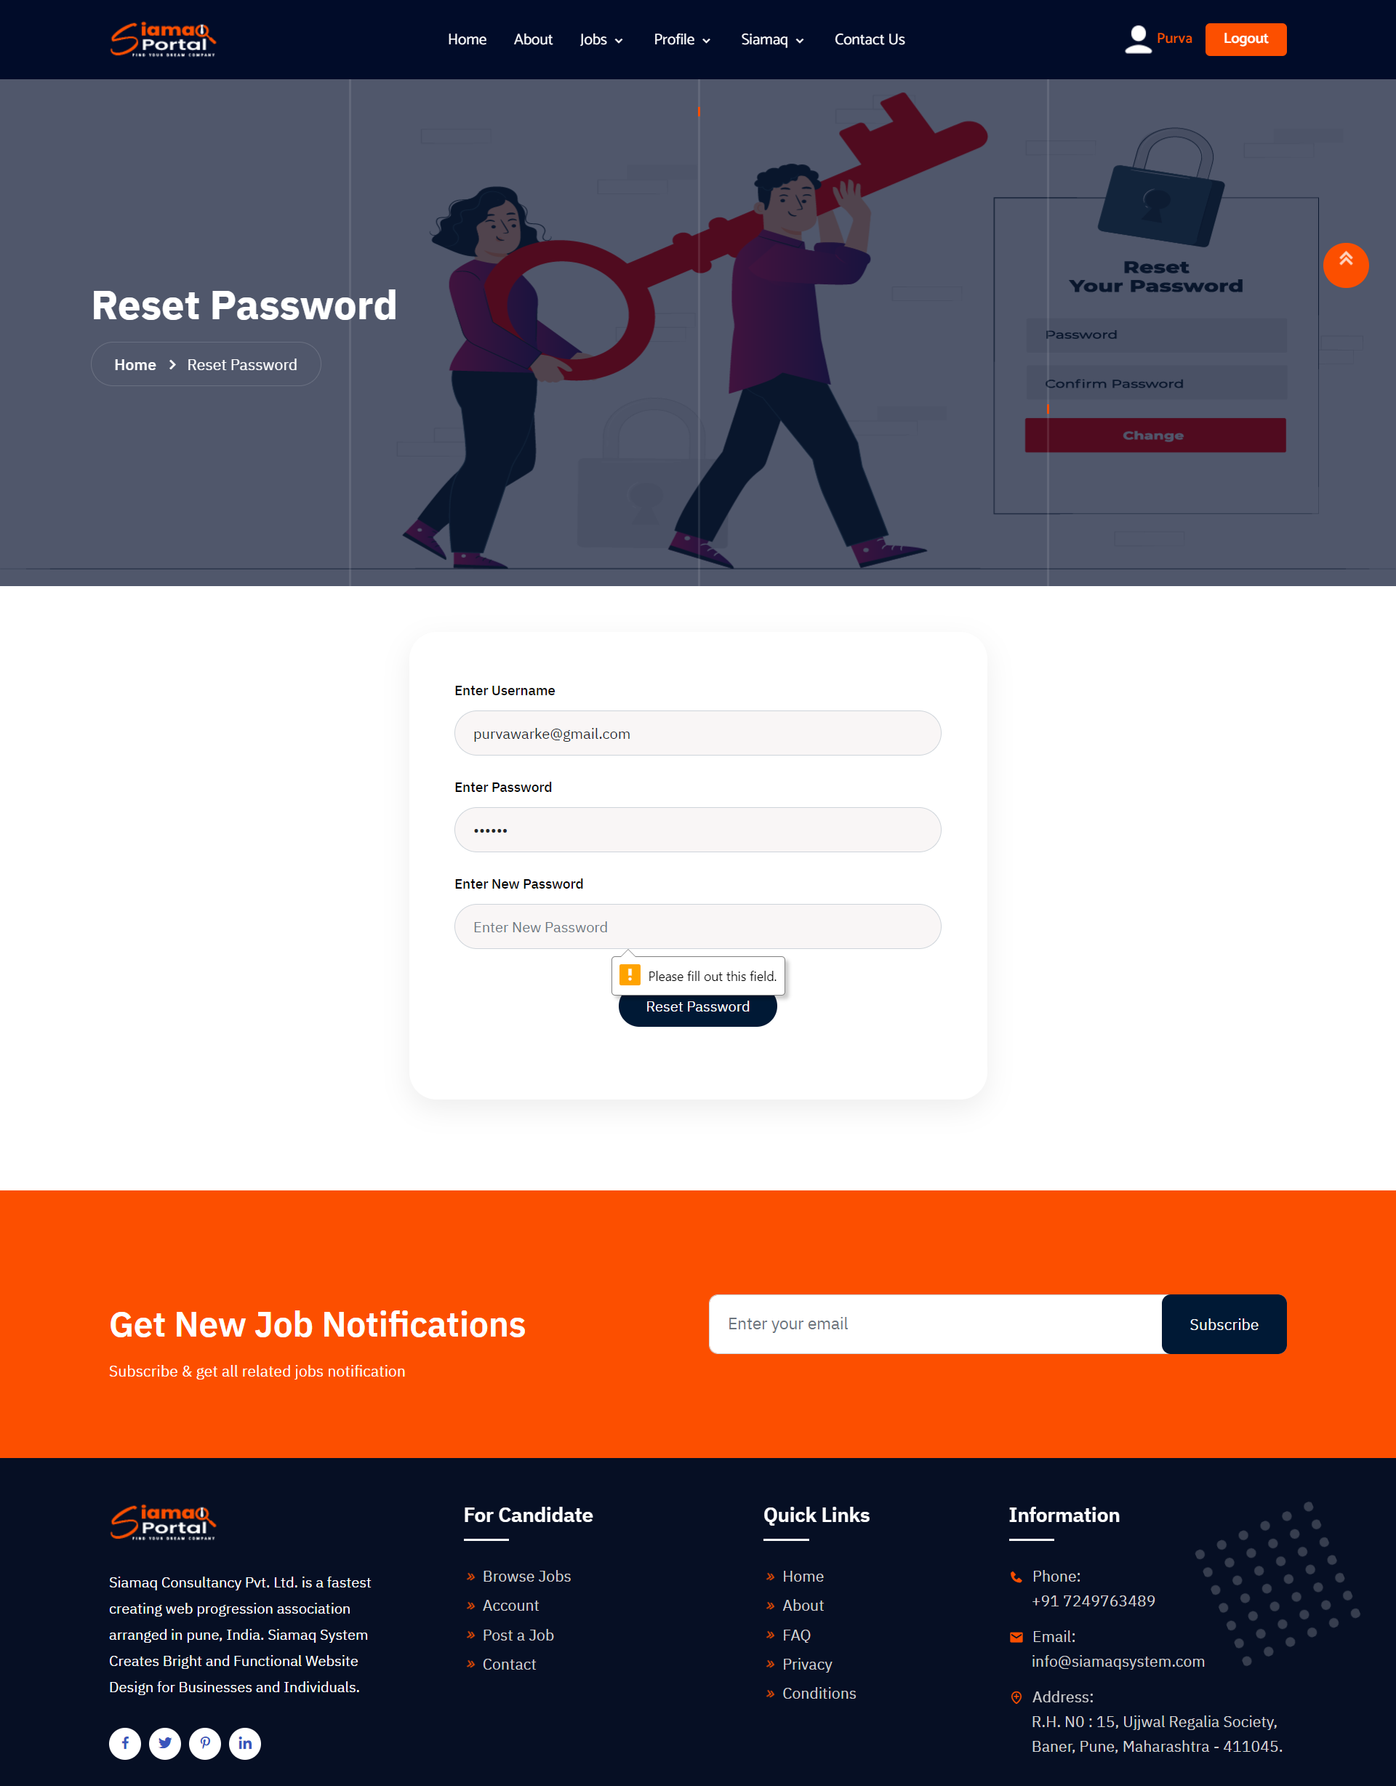
Fig 2. Reset Password Page

Slide 35
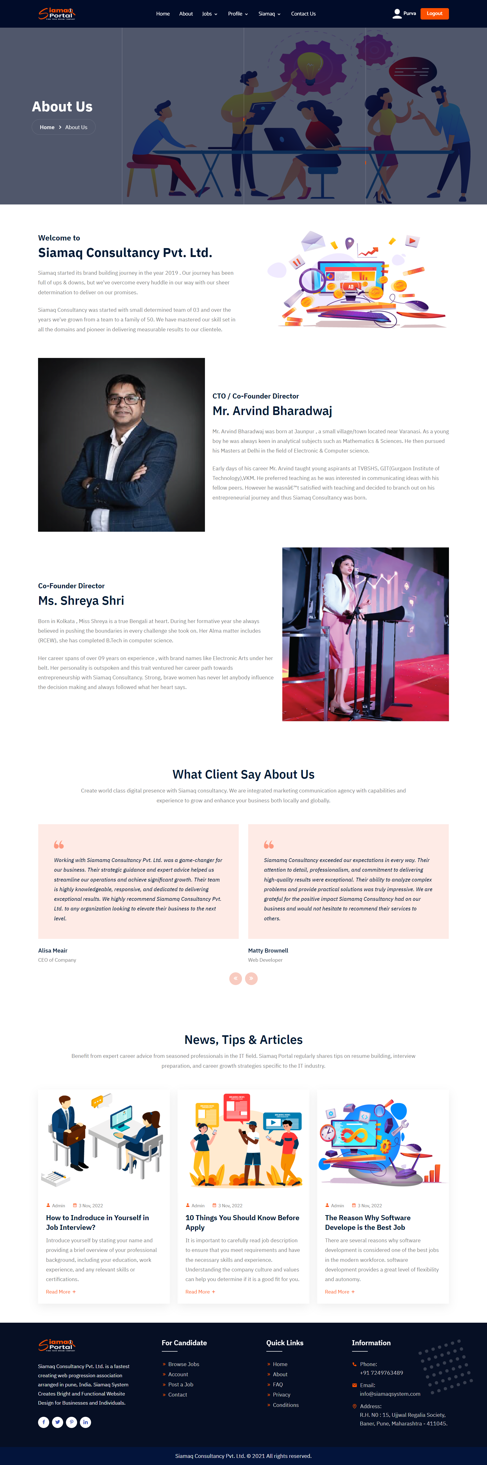
Fig 5.2 About Page

Slide 36
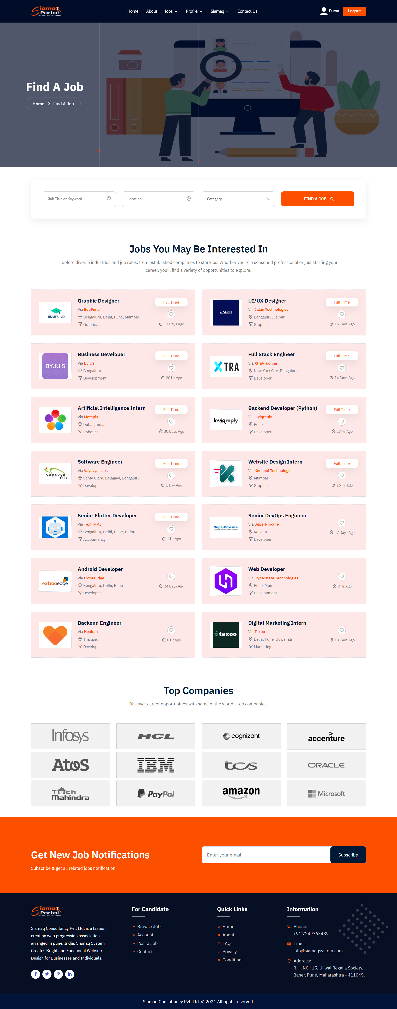
Fig 6.1 Find A Job Page

Slide 37
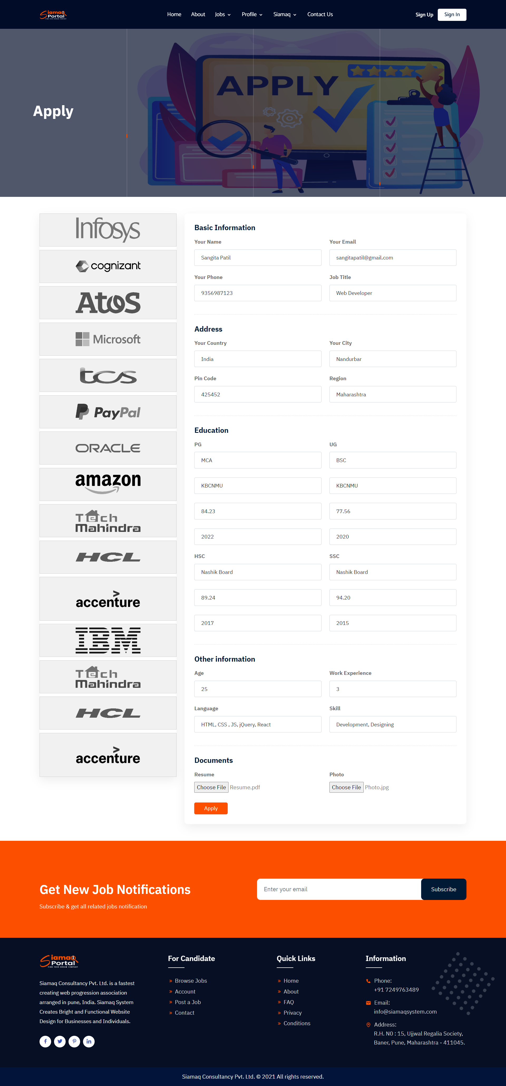
Fig 7.2 Job Apply Page

Slide 38
Fig 9. Job Apply Page

Slide 39
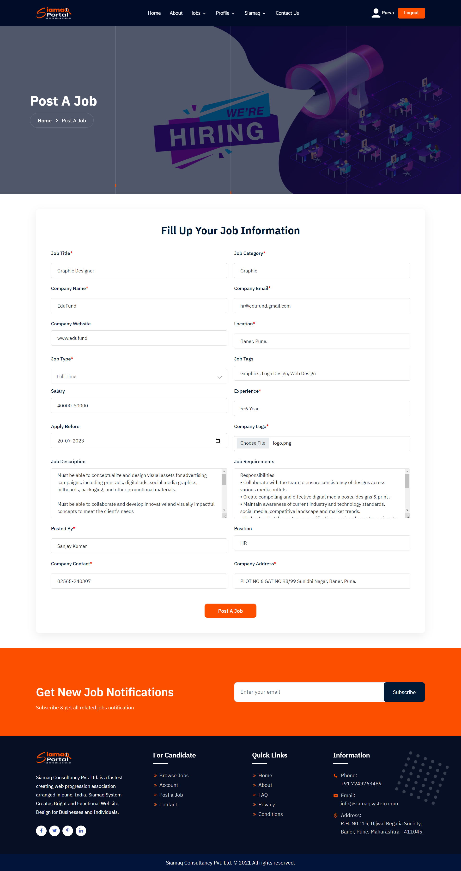
Fig 7.2 Job Details Page

Slide 40
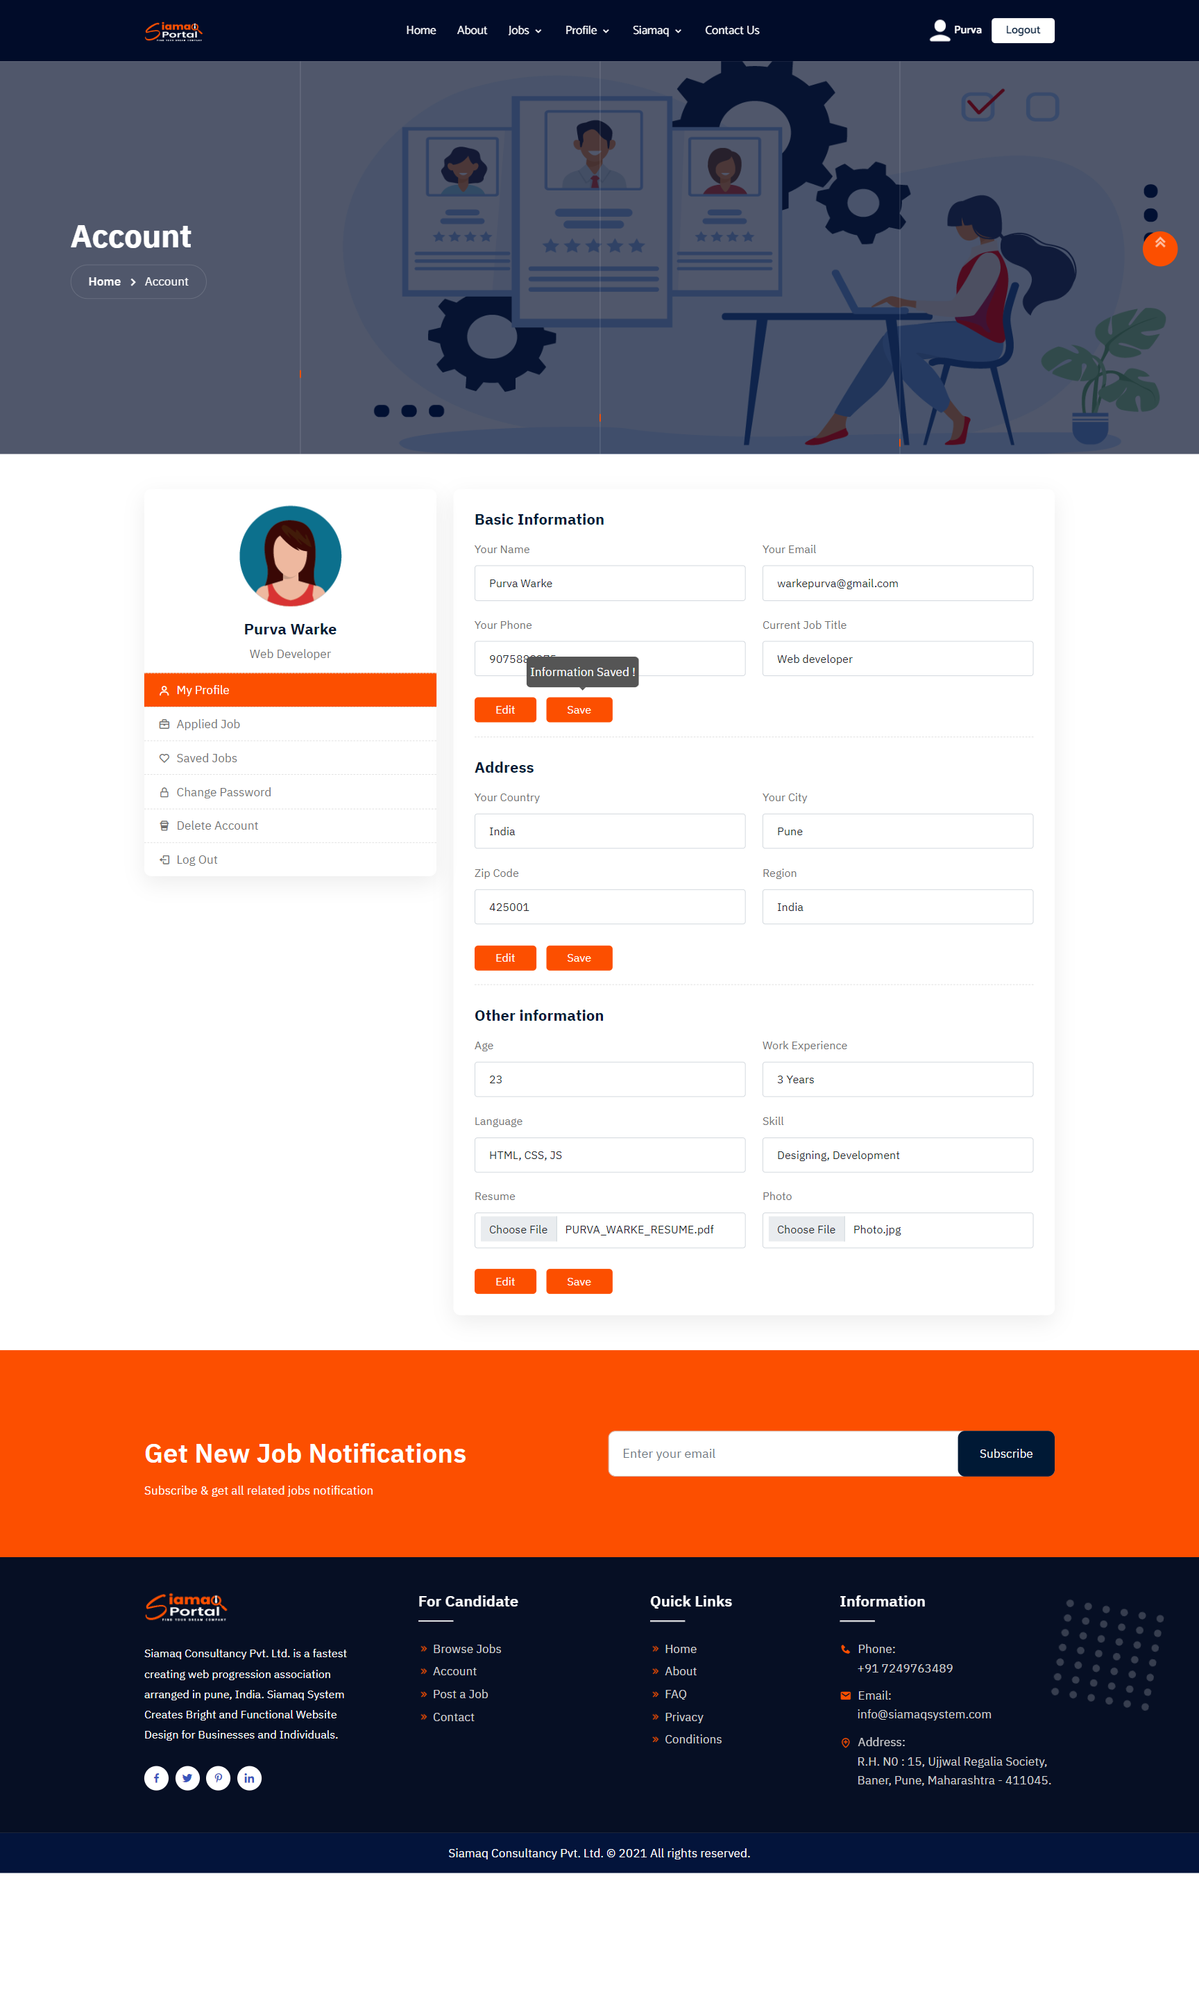
Fig 10.1 Account Page (Save Option )

Slide 41
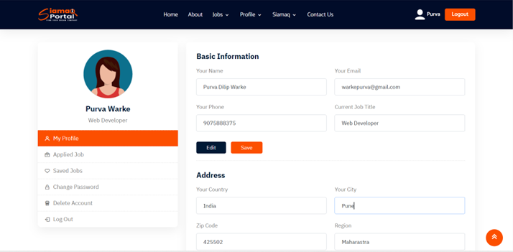
Fig 10.2 Account Page (Edit Option )

Slide 42
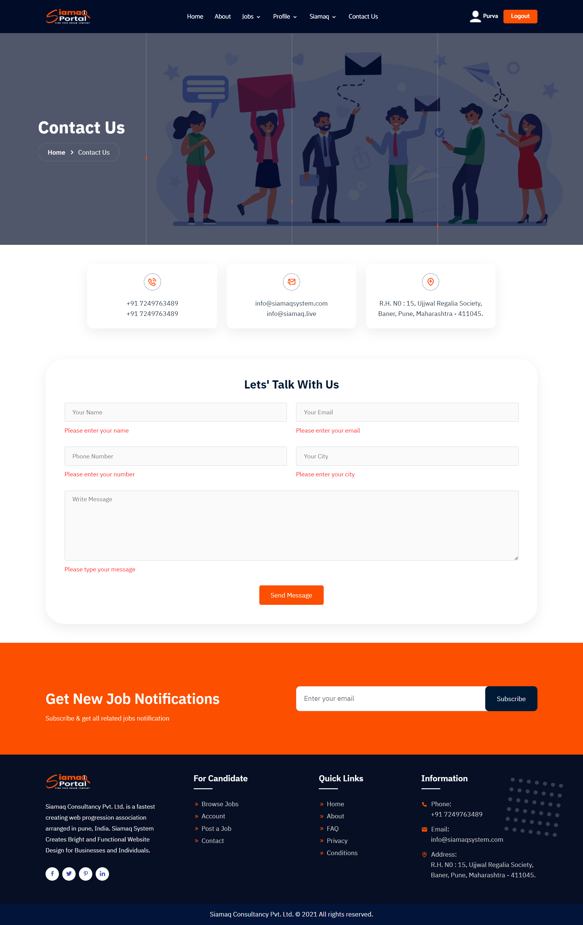
Fig 11. Contact Page

Slide 43
06
CONCLUSION

Slide 44
6.1 BENEFITS OF SYSTEM
Easy Application Process :- Job seekers can apply for jobs directly through the portal, eliminating the need for traditional application methods like mailing physical resumes. They can create online profiles, upload resumes, and submit applications with just a few clicks, making the process quick and convenient.
Enhanced Visibility for Job Seekers :- The job portal increases job seekers' visibility to potential employers. By creating an online profile and uploading their resume, they can showcase their skills, experience, and qualifications to companies actively seeking talent.
Efficient Recruitment for Companies :- The portal simplifies the recruitment process for companies. Employers can create detailed job postings, specify required qualifications, and receive applications directly through the platform. This streamlines the hiring process and helps companies find suitable candidates more efficiently.

Slide 45
6.1 BENEFITS OF SYSTEM
Time and Cost Savings :- Using the job portal saves both job seekers and companies time and costs associated with traditional recruitment methods. Job seekers can apply to multiple positions with ease, while companies can reach a wider pool of candidates without the need for extensive advertising or manual application screening
Wide Range of Job Opportunities :- The job portal provides access to a diverse range of job opportunities across various industries and sectors. Job seekers can explore a wide array of positions that match their skills, qualifications, and career goals.

Slide 46
6.2 STRENGTH OF SYSTEM
Some companies are worry of hiring employee's so this site is best for them to hiring employee's in there company's.
Anyone can post a job online because the process clear, easy to understand and user-friendly. Conversely, the process is very simple for the applicant, too, making it quick and painless for interested parties to apply on the spot instead of mailing CVs and written applications through the post.

Slide 47
6.3 WEAKNESS OF SYSTEM
They have no screening. Anyone can sign up for a profile and apply for a job on an online job portal - no matter their credentials. With no official screening process in place, the website you’re using can allow unlimited unqualified candidates to apply. Reviewing unqualified applications is an even further waste of your time.
They’re ineffective for high-level positions. Because they have no screening process and allow companies to post for a wide variety of jobs, online job search websites tend to be better choices for entry-level positions. Your high-level position won’t get the attention or the kind of candidates you need.

Slide 48
6.4 FUTURE WORK
This project fulfils the primary requirements of the job seekers and employers. It can be extended in several ways – We can provide recommendations and email updates for new job postings based on the job seeker’s search history. Since, the job seekers might be interested in building a strong Resume, we can provide tips and information for the same. We can also provide templates for building the Resumes which might interest most applicants. The mobile application is developed fulfilling the functionalities of job seeker, it can be extended to support functionalities of Employer as well

Slide 49
07
REFERENCES

Slide 50
7.1 BOOKS
"Learning Web Design" by Jennifer Niederst Robbins.
"JavaScript: The Good Parts" by Douglas Crockford.
"Database Systems" by Thomas Connolly and Carolyn Begg.
"Bootstrap 4 Quick Start" by Jacob Lett.
"MySQL Cookbook" by Paul DuBois.

Slide 51
7.2 WEBSITES
https://www.usajobs.gov/
https://www.careerbuilder.com/regional_sites
https://www.ziprecruiter.co.uk/?utm_source=ziprecruiter-com-redirect
https://www.visual-paradigm.com/tutorials/data-flow-diagram-dfd.jsp
https://www.linkedin.com/jobs
https://www.naukri.com/mnjuser/homepage
https://www.siamaqsystem.com/
https://www.w3schools.in/sdlc/agile-model
https://www.w3schools.com/html/
https://www.startbootstrap.com
https://www.javatpoint.com/
http://www.indeed.com/

Slide 52
THANKS YOU !

